Slide 1
Strategy meeting:
Expansion to the Brazilian market via Magist

Slide 2
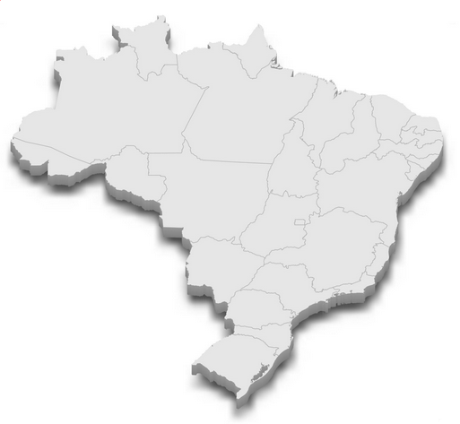
The Brazilian Market
3rd Largest Economy
in western Hemisphere
(1.92 trillion US$)
Fast growing eCommerce market:
2018: 53 Billion US$
2024: 126 Billion US$
2nd largest population
in the Western Hemisphere
(215 million)

Slide 3
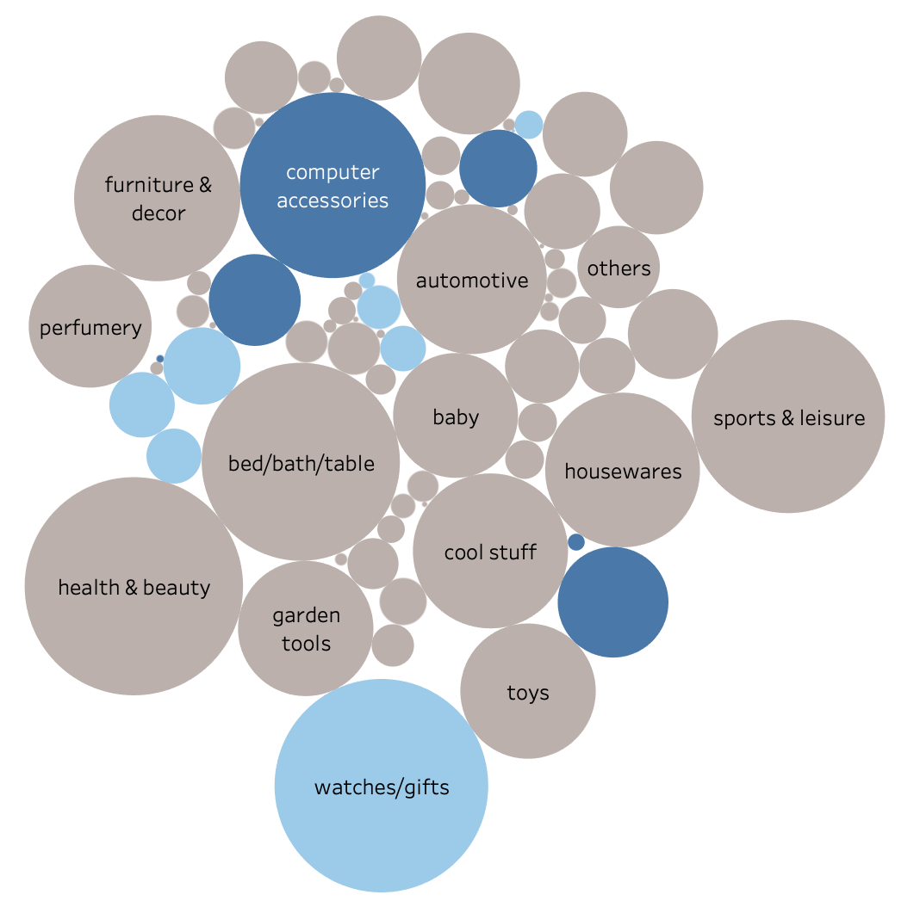
Who is Magist?
electronics
Software as a Service company
for centralized order management
computers
Connect stores to marketplaces
Stock and warehouse management
Advantageous contracts
Comprehensive Delivery Tracking
Adaptable Logistics Network
telephony

Slide 4
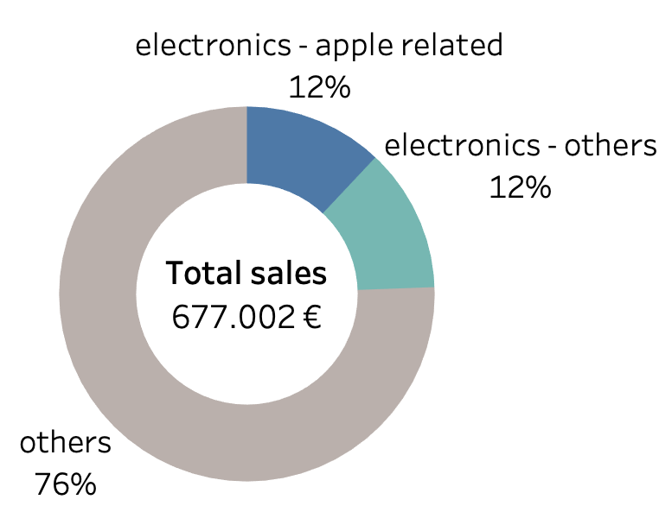
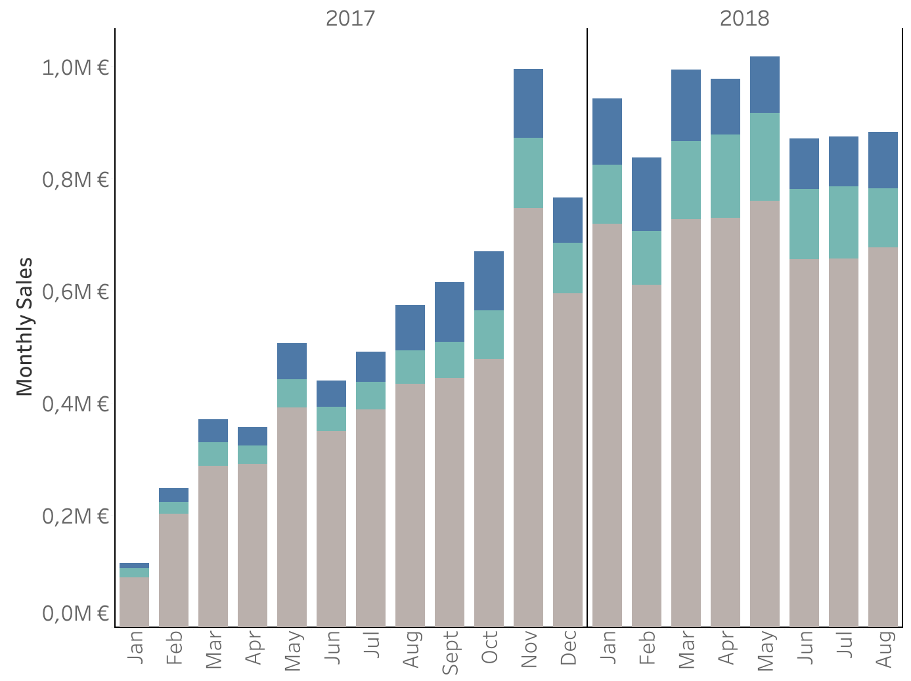
Average monthly sales and growth rate
Average monthly sales
Development of Magist’s monthly sales
Electronics sales:
~ 160.000 €
Eniac’s revenue:
~ 1.2M €
Reasonable percentage of sold goods correlate with Eniac’s portfolio
However: small overall sales revenue
Significant sales growth over last 2 years. Future trends unclear.

Slide 5
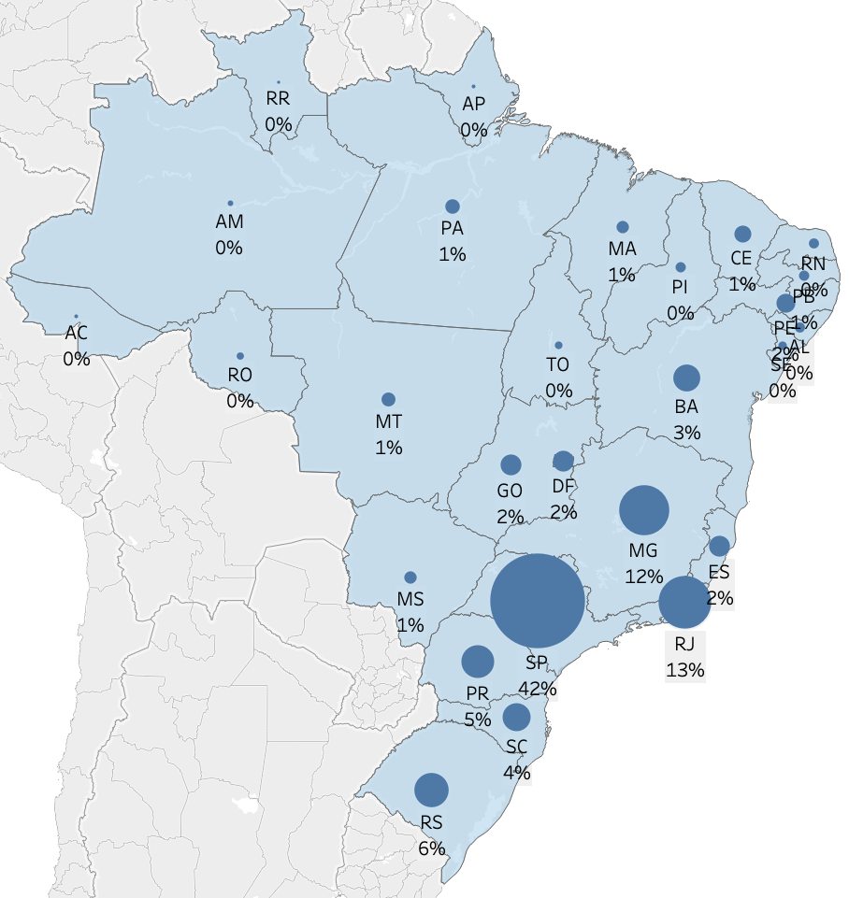
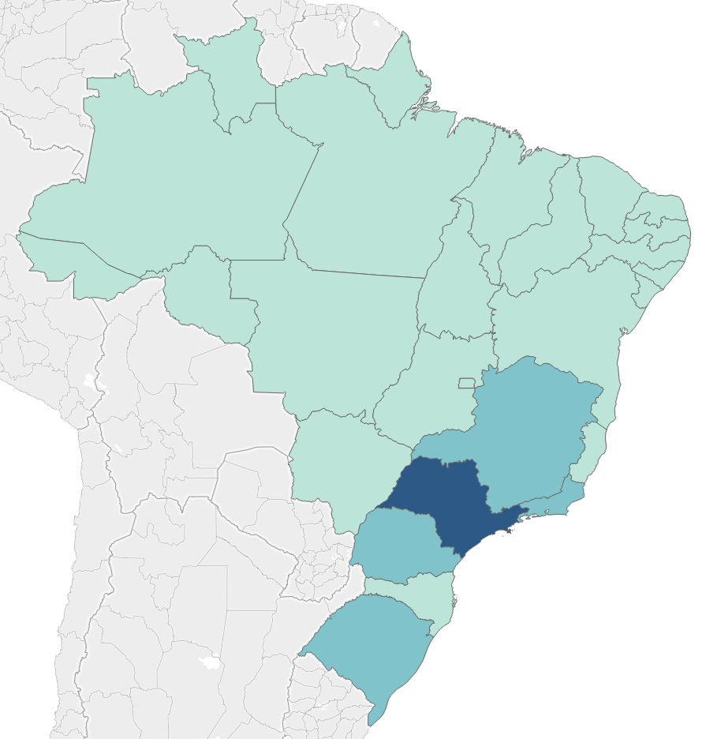

Regional sales vs. population and income
customers per state
Main sales in major economic regions: São Paulo (SP), Rio de Janeiro (RJ), Minas Gerais (MG)
Less sales in northern regions
Lower average income
Further geographical disadvantages?

Slide 6
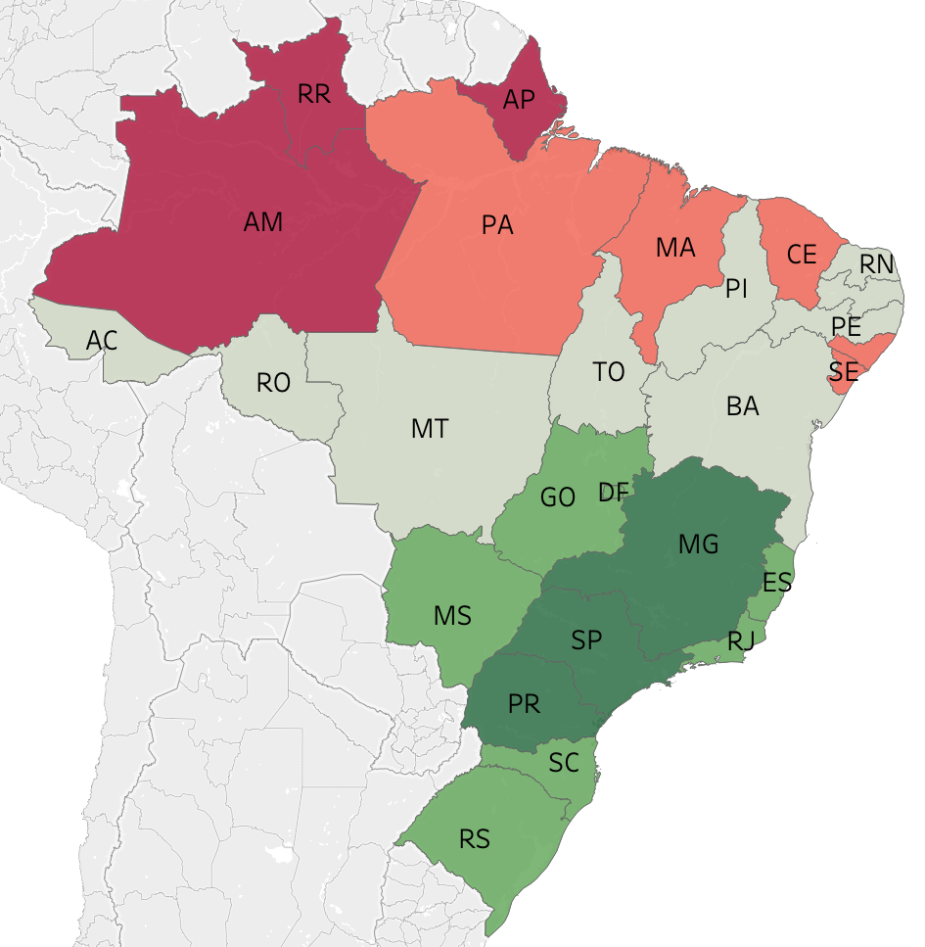

Delivery Times
Average delivery time: 12 days
No significant difference among product categories
Sellers mainly located in the south
→ Longer delivery times mainly for northern states
Major Cities (e.g., São Paulo, Rio de Janeiro)
3 to 7 business days.
Mid-Sized Cities and Surrounding Areas:
5 to 10 business days.
Remote Areas and Northern Regions:
7 to 15 business days.

Slide 7
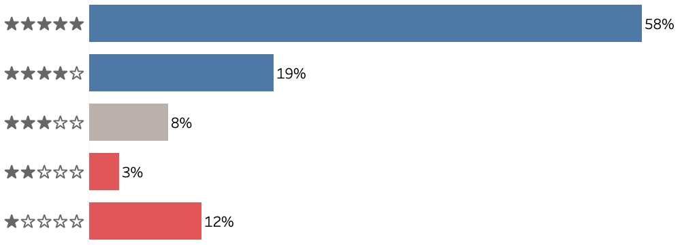
Customer Reviews
The product came with a defect, it only works occasionally!
Customer satisfaction breakdown by rating
Excellent service and agility in the service, I recommend it.
Average: 4.1
Item arrived 2 days after purchase! Way ahead of schedule!
They simply did not deliver it and did not even provide any explanation!
Very satisfied in every way!

Slide 8
Pros
Cons
Increase company's profit
Delivery times acceptable
Magist sales revenue increases
Overall positive reviews (average score of 4.1/5)
Risk to enter new market
Geographical disparities
Sales Growth rate might stagnate
Small total sales revenue compared to Eniac standards
→ Conclusion: Considering an alternative is advisable
→ Alternatives: Mercado Libre, Novatrade or
Fulfillment Services of bigger players such as Amazon or Shopify

Slide 9
Strategy meeting:
Expansion to the Brazilian market via Magist

